Slide 1
You can choose to install the XDJ-XZ mapping with or without BOME.
TO INSTALL WITHOUT BOME:
Just install the TSI as a normal Traktor mapping
Configure the controller manager to “XDJ-XZ (1)”
Ignore the “XDJ-XZ (2)” device
WHAT WILL YOU LOSE?
Jog screens
All traktor MacroFX and MixerFX
(Pioneer SoundColorFX hardware effects will still be there)
Any future updates to this mapping

Slide 2
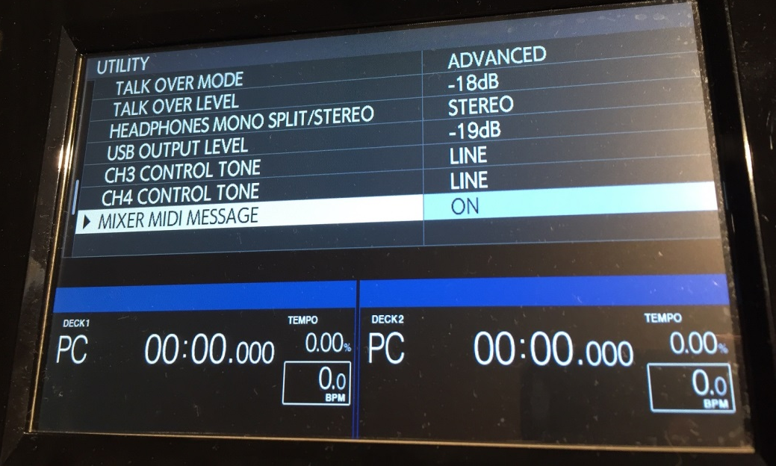
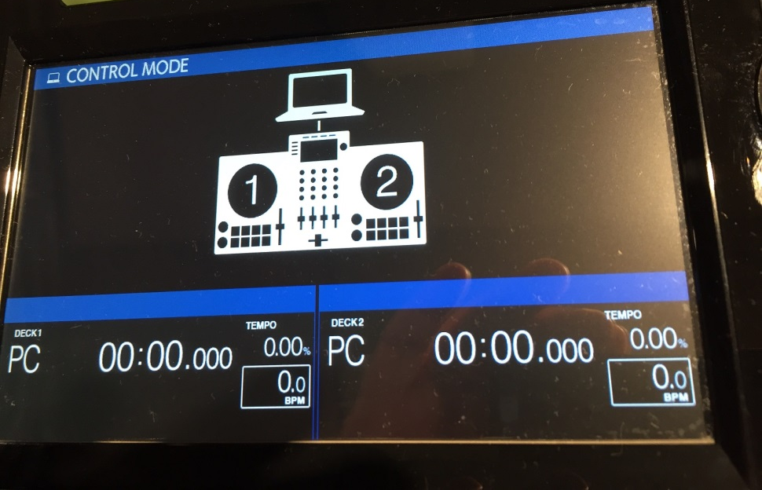
XDJ Config:
More info: See page 128 of the Pioneer Manual: https://github.com/pestrela/music/blob/master/ddj/4%20Manuals/XDJ-XZ%20-%20Full%20Manual.pdf
XDJ-XZ features video: https://www.youtube.com/watch?v=7EPfY9bGGlw&list=PLIlvTGzSxI0UV1oJfRDL4fYY9oRyLkBik&index=1

Slide 3
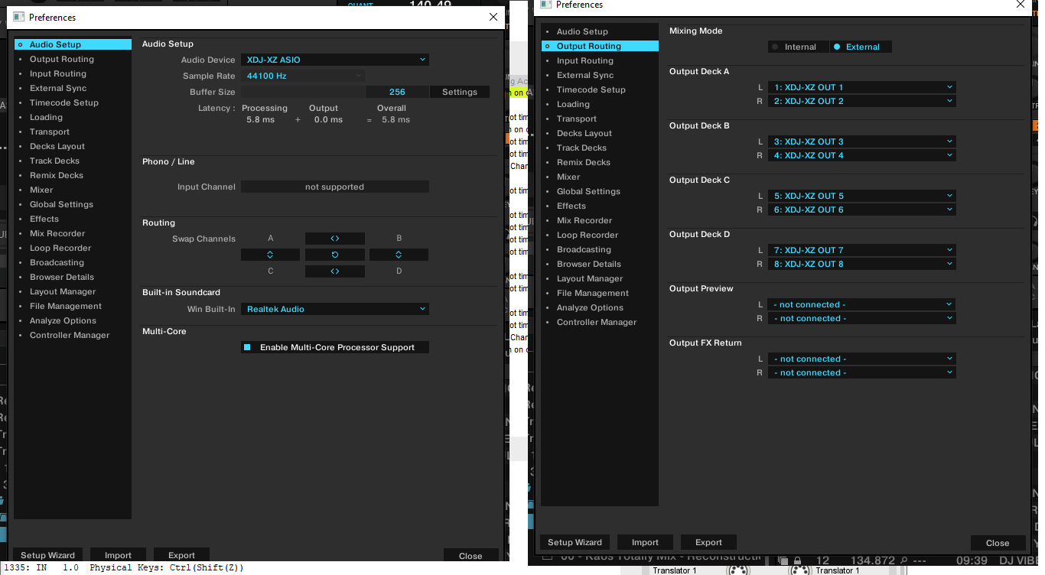
Traktor config:

Slide 4
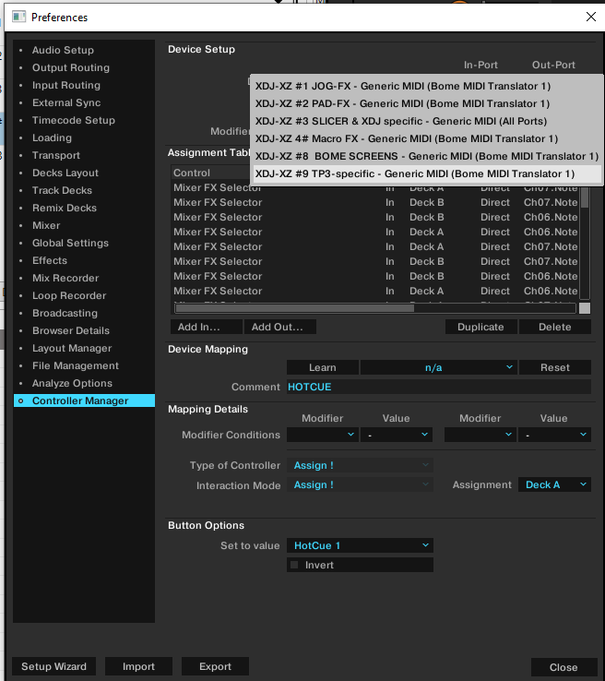
WITHOUT bome,
do put XDJ-XZ (1) here!!!

